Slide 1
Ternary Phase Diagrams
CompuTherm LLC
8401 Greenway Blvd, Suite 248
Middleton, WI 53562, USA
www.computherm.com
Copyright © CompuTherm LLC

Slide 2
Reading 2-D Ternary Phase Diagrams
Isothermal Section
Isopleth
Liquidus Projection
Lever Rule in Ternary Field

Slide 3
Reading 2-D Ternary Phase Diagrams
Isothermal Section:
Fixed Temperature
Composition represented on equilateral Triangle
C
X_{A}
X_{B}
For low concentration of one component, use a right-angled triangle (e.g. Fe-Cr-C)
C
X_{C}
X_{C}
A
B
X_{C}
X_{B}
X_{A}
A
B
X_{B}
X_{A}=1-X_{B}-X_{C}

Slide 4
Reading 2-D Ternary Phase Diagrams
Isothermal Section:
Phase boundary (Blue)
Tie-line (Green)
Tie-triangle (Red)

Slide 5
Reading 2-D Ternary Phase Diagrams
Isopleth:
Y-axis: temperature
X-axis: composition
Tie-line may not lie on the section

Slide 6
Reading 2-D Ternary Phase Diagrams
Liquidus Projection:
Univariant line (Blue)
Isothermal line (Green)
Primary phase region

Slide 7
Reading 2-D Ternary Phase Diagrams
Isothermal Section:
Lever rule on tie-line
N
γ
P
Alloy
M
α
In Alloy P, two phases are in equilibrium:
Fraction of α = Length(PN) / Length(MN)
Fraction of γ = Length(MP) / Length(MN)

Slide 8
Reading 2-D Ternary Phase Diagrams
Isothermal Section:
Lever rule on tie-triangle
N
γ
P
Alloy
M
O
α
β
In Alloy P, three phases are in equilibrium:
Fraction of α = Area(PON) / Area(MNO)
Fraction of β = Area(PMN) / Area(MNO)
Fraction of γ = Area(POM) / Area(MNO)

Slide 9
Types of Ternary Phase Diagrams
Isomorphous System
Ternary Three-phase Equilibrium
Ternary Four-phase Equilibrium
  Class I Reaction
  Class II Reaction
  Class III Reaction
Congruent Transformation
A Complex System

Slide 10
Isomorphous Systems - Case I
Case I: Three binaries are all isomorphous with Cigar shape phase boundaries.

Slide 11
Isomorphous Systems - Case I
Case I: Isothermal sections in decreasing T order.

Slide 12
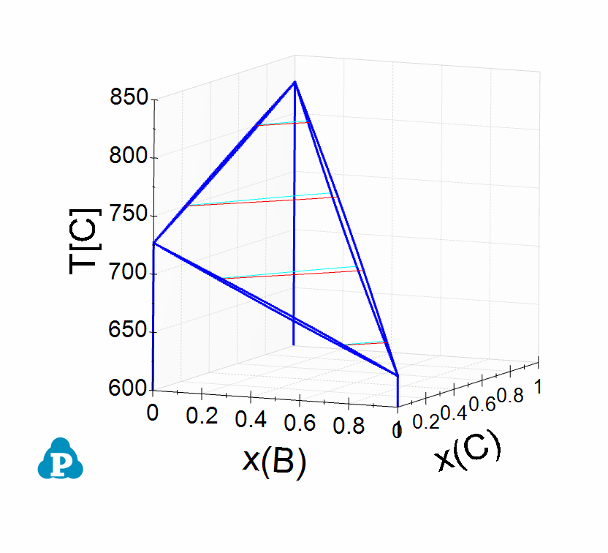
Isomorphous Systems - Case I
Case I: Liquidus projection has no univariant line.
Liquidus Projection in 2-D view
Liquidus Projection in 3-D view

Slide 13
Isomorphous Systems - Case I
Case I: Isopleths parallel to the B-C binary

Slide 14
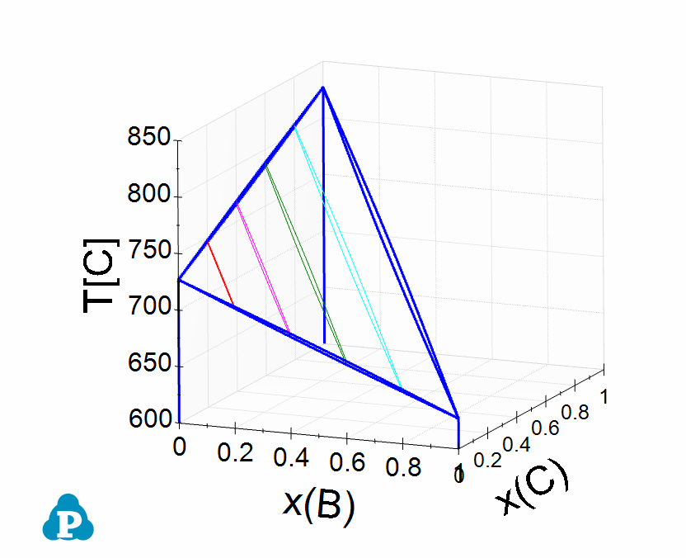
Isomorphous Systems - Case I
Case I: Isopleths in 3-D view

Slide 15
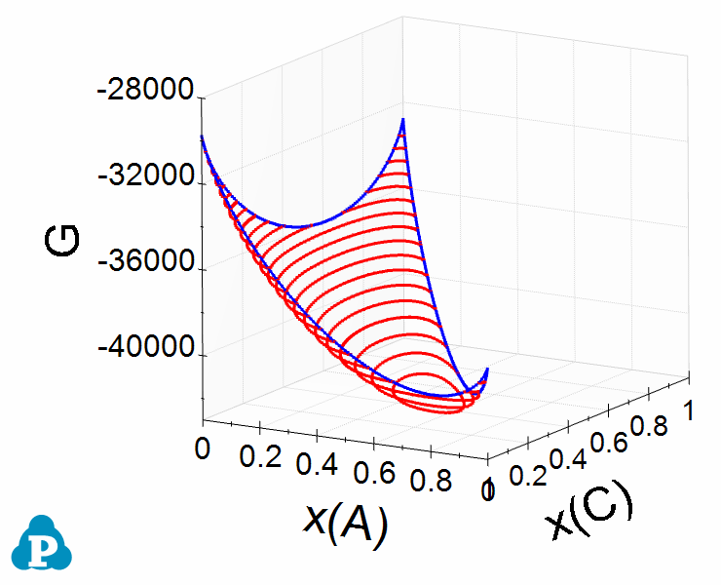
Isomorphous Systems - Case I
Case I: Gibbs energy surface for Liquid at 700ºC

Slide 16
Isomorphous Systems - Case II
Case II: Three binaries are all isomorphous with 2 Cigar shape phase boundaries and 1 maximum.

Slide 17
Isomorphous Systems - Case II
Case II: Isothermal sections in decreasing T order.

Slide 18
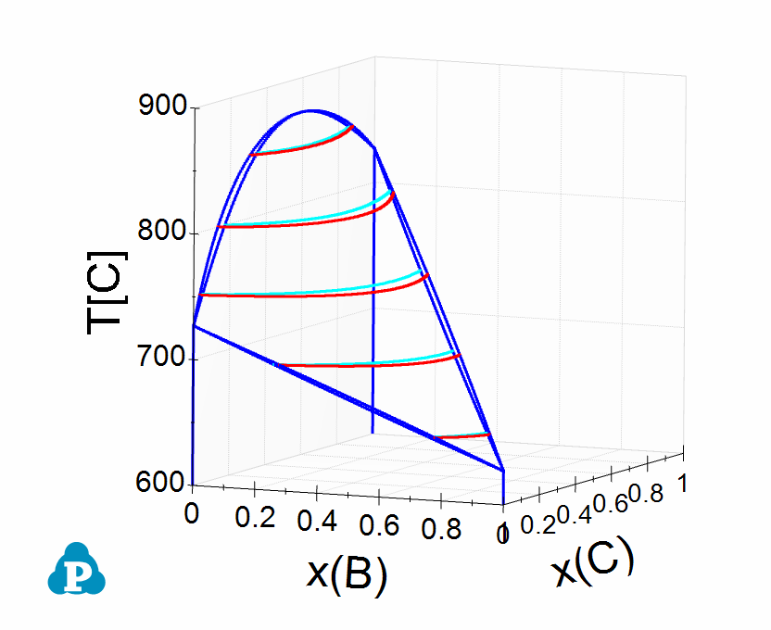
Isomorphous Systems - Case II
Case II: Liquidus projection has no univariant line.
Liquidus Projection in 2-D view
Liquidus Projection in 3-D view

Slide 19
Isomorphous Systems - Case II
Case II: Isopleths parallel to the B-C binary

Slide 20
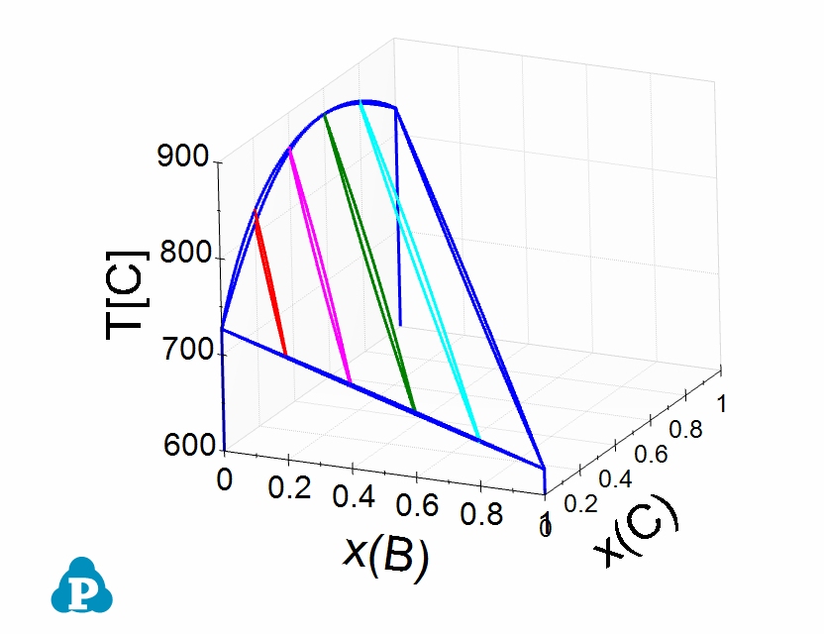
Isomorphous Systems - Case II
Case II: Isopleths in 3-D view

Slide 21
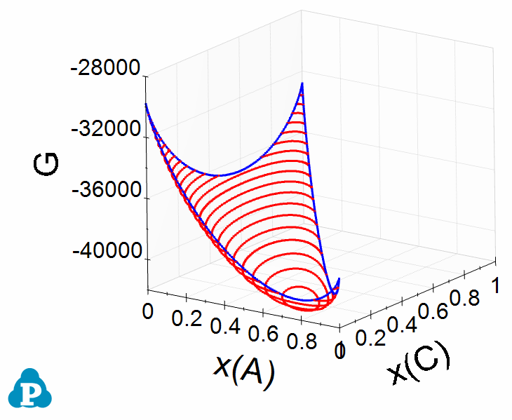
Isomorphous Systems - Case II
Case II: Gibbs energy surface for Liquid at 700ºC

Slide 22
Isomorphous Systems - Case III
Case III: Three binaries are the same as those in case I. There is a maximum melting point in the ternary phase field.

Slide 23
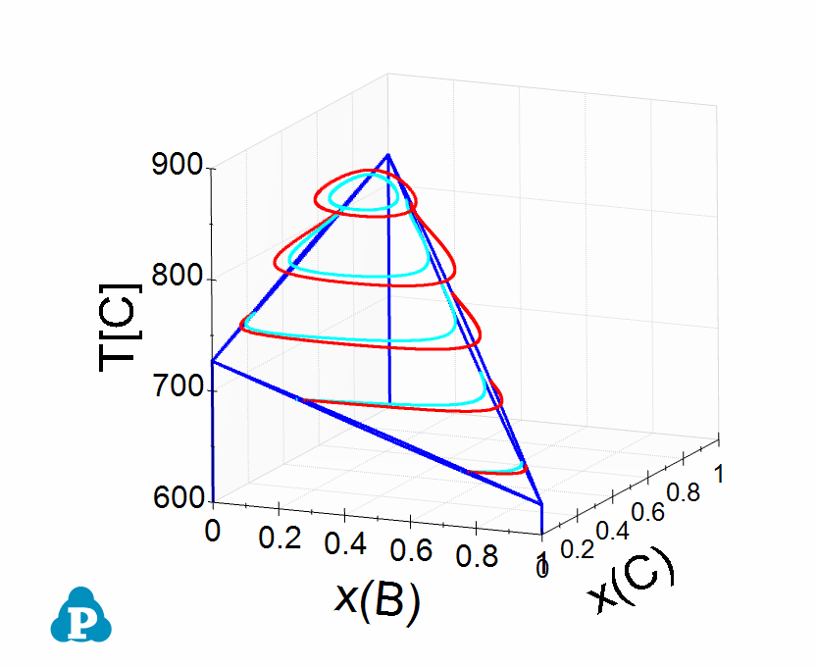
Isomorphous Systems - Case III
Case III: Liquidus projection has no univariant line.
Liquidus Projection in 2-D view
Liquidus Projection in 3-D view

Slide 24
Isomorphous Systems - Case III
Case III: Isopleths parallel to the B-C binary

Slide 25
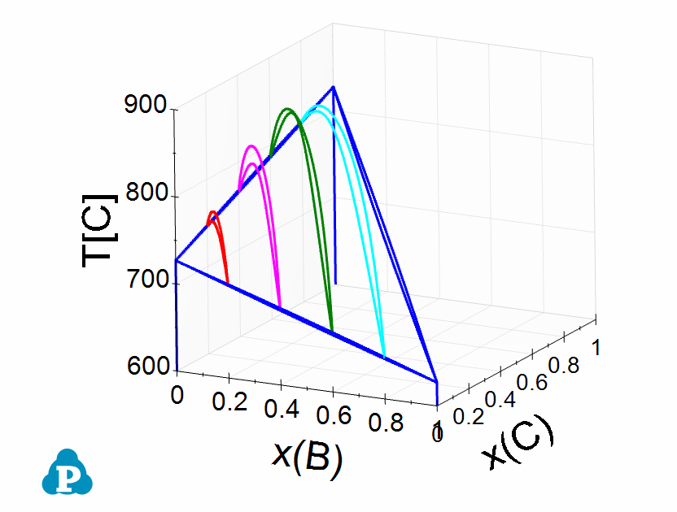
Isomorphous Systems - Case III
Case III: Isopleths in 3-D view

Slide 26
Types of Ternary Phase Diagrams
Isomorphous System
Ternary Three-phase Equilibrium
Ternary Four-phase Equilibrium
  Class I Reaction
  Class II Reaction
  Class III Reaction
Congruent Transformation
A Complex System

Slide 27
Ternary Three-Phase Equilibrium - Case I
Case I: Two eutectic binary systems and one isomorphous with Cigar shape phase boundary.

Slide 28
Ternary Three-Phase Equilibrium - Case I
Case I: Isothermal sections in decreasing T order.

Slide 29
Ternary Three-Phase Equilibrium - Case I
Case I: Isothermal sections in decreasing T order.

Slide 30
Ternary Three-Phase Equilibrium - Case I
Liquidus has one univariant line starting from A-B binary and ending at B-C binary, which separates 2 primary phase fields, Fcc and Bcc.

Slide 31
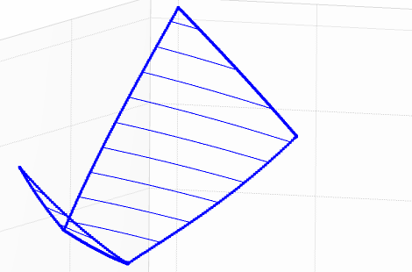
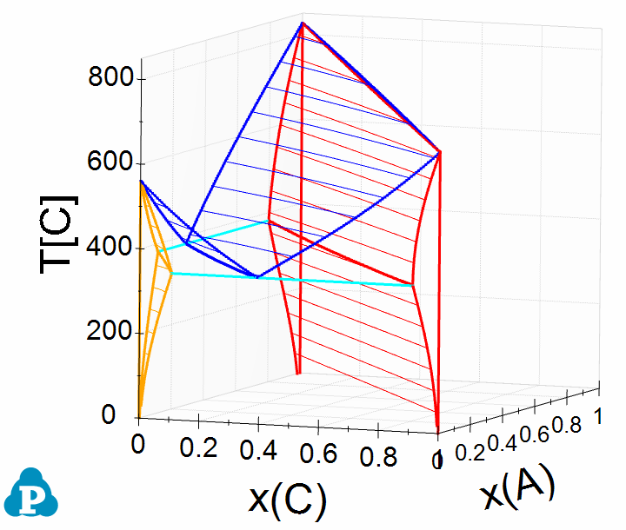
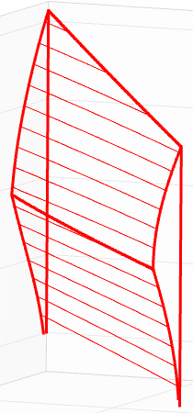
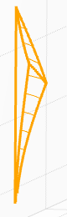
Ternary Three-Phase Equilibrium - Case I
Ternary phase fields in 3-D view
Liquid phase: Blue
Fcc phase: Red
Bcc phase: Orange

Slide 32
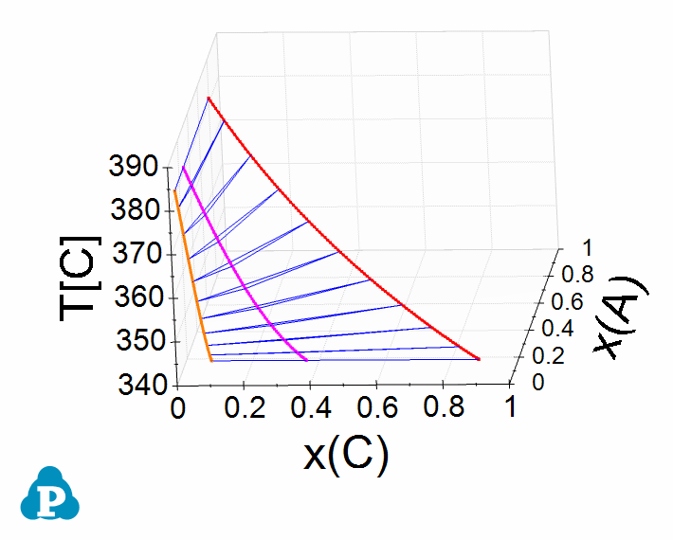
Ternary Three-Phase Equilibrium - Case I
Liquid+Fcc+Bcc Tie-triangle changes in ternary field
Liquid phase: Fuchsia
Fcc phase: Red
Bcc phase: Orange

Slide 33
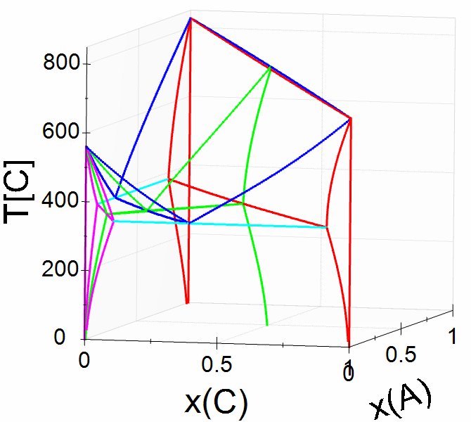
Ternary Three-Phase Equilibrium - Case I
Isopleth through B-A_{0.5}C_{0.5} (Green line in 3D view)

Slide 34
Ternary Three-Phase Equilibrium - Case II
Case II: Two peritectic binary systems and one isomorphous with Cigar shape phase boundary.

Slide 35
Ternary Three-Phase Equilibrium - Case II
Case II: Isothermal sections in decreasing T order.

Slide 36
Ternary Three-Phase Equilibrium - Case II
Liquidus has one univariant line starting from A-B binary and ending at B-C binary, which separates 2 primary phase fields, Fcc and Bcc.

Slide 37
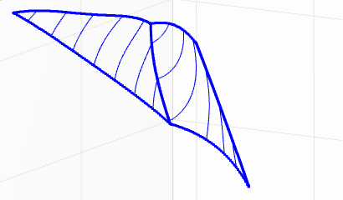
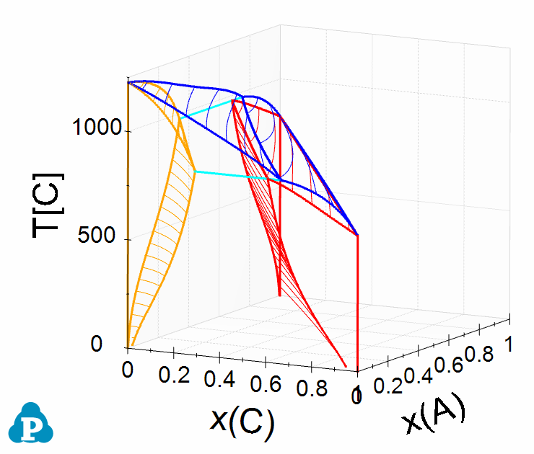
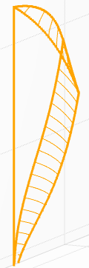
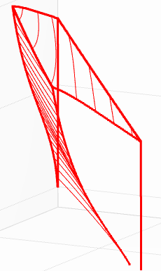
Ternary Three-Phase Equilibrium - Case II
Ternary phase fields in 3-D view
Liquid phase: Blue
Fcc phase: Red
Bcc phase: Orange

Slide 38
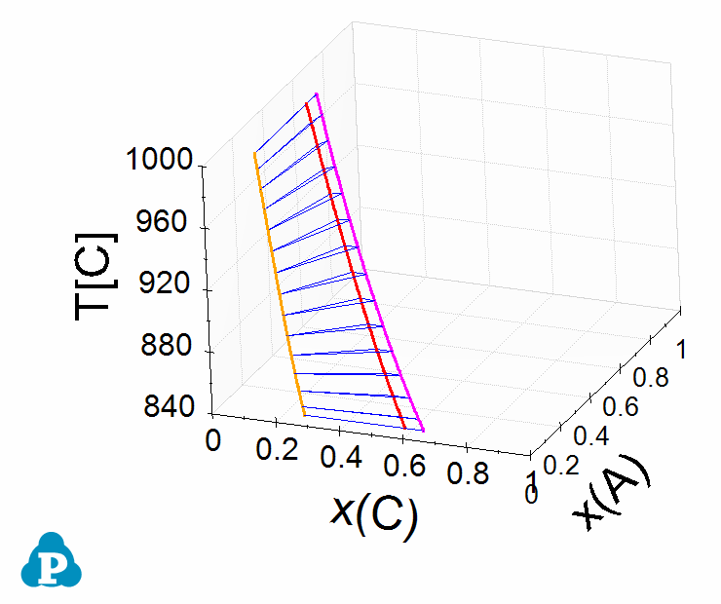
Ternary Three-Phase Equilibrium - Case II
Liquid+Fcc+Bcc Tie-triangle changes in ternary field
Liquid phase: Fuchsia
Fcc phase: Red
Bcc phase: Orange

Slide 39
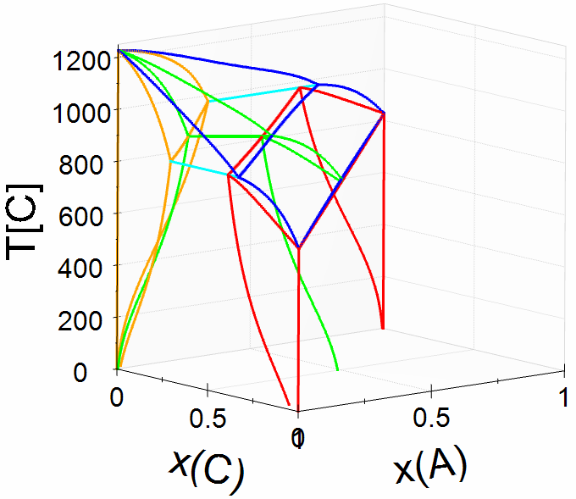
Ternary Three-Phase Equilibrium - Case II
Isopleth through B-A_{0.5}C_{0.5} (Green line in 3D view)

Slide 40
Ternary Three-Phase Equilibrium - Case III
Case III: One peritectic binary, one eutectic binary and one isomorphous with Cigar shape phase boundary.

Slide 41
Ternary Three-Phase Equilibrium - Case III
Case III: Isothermal sections in decreasing T order.

Slide 42
Ternary Three-Phase Equilibrium - Case III
Liquidus has one univariant line starting from A-B binary and ending at B-C binary, which separates 2 primary phase fields, Fcc and Bcc.

Slide 43
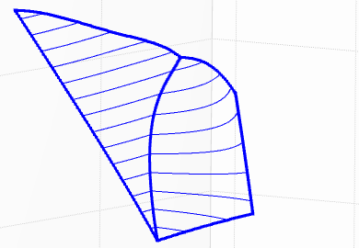
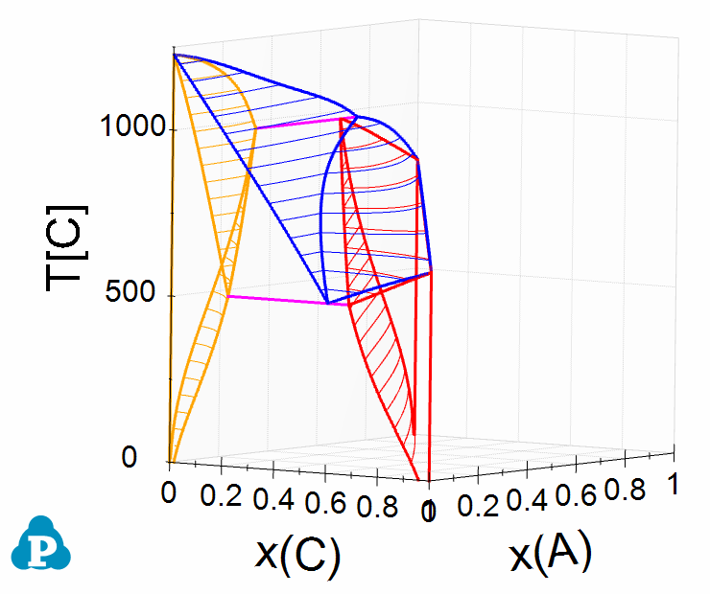
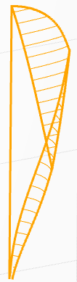
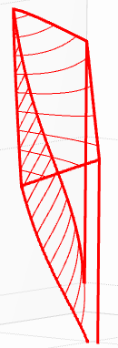
Ternary Three-Phase Equilibrium - Case III
Ternary phase fields in 3-D view
Liquid phase: Blue
Fcc phase: Red
Bcc phase: Orange

Slide 44
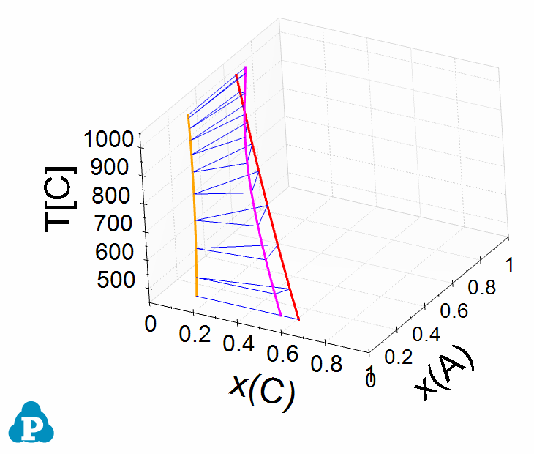
Ternary Three-Phase Equilibrium - Case III
Liquid+Fcc+Bcc Tie-triangle changes in ternary field
Liquid phase: Fuchsia
Fcc phase: Red
Bcc phase: Orange

Slide 45
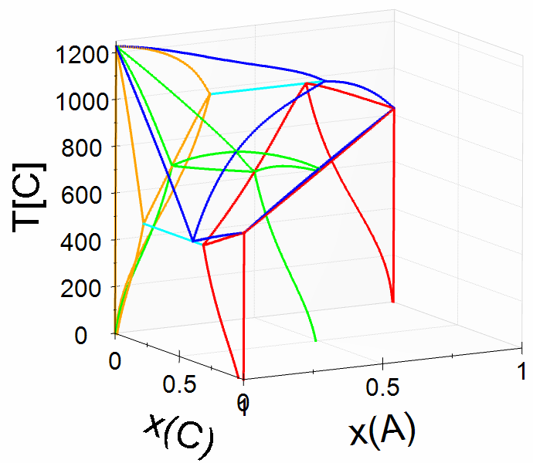
Ternary Three-Phase Equilibrium - Case III
Isopleth through B-A_{0.5}C_{0.5} (Green line in 3D view)

Slide 46
Ternary Three-Phase Equilibrium - Case IV
Case IV: One eutectic binary and Two isomorphous with Cigar shape phase boundary.

Slide 47
Ternary Three-Phase Equilibrium - Case IV
Case IV: Isothermal sections in decreasing T order.

Slide 48
Ternary Three-Phase Equilibrium - Case IV
Liquidus has one univariant line starting from A-B binary and ending at a minimum in the ternary field, and only one primary phase field, Fcc.

Slide 49
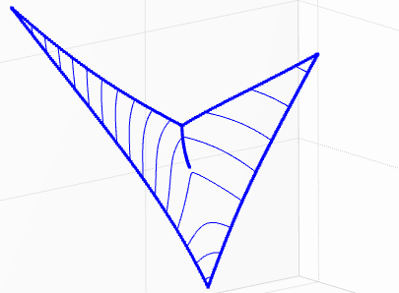
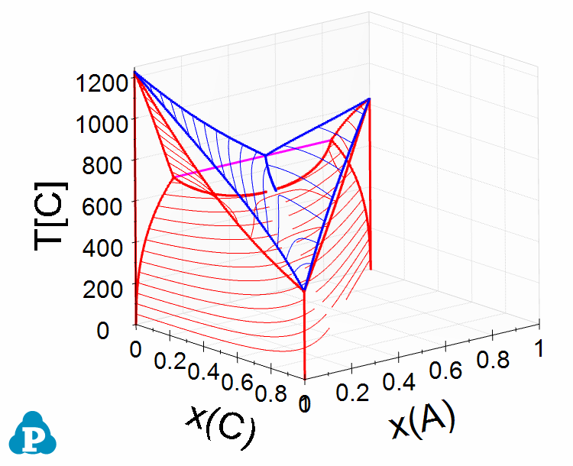
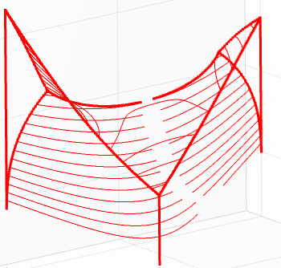
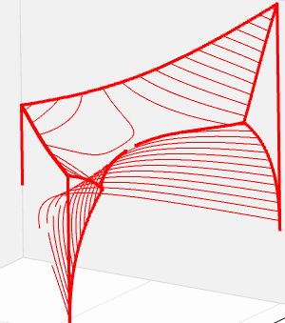
Ternary Three-Phase Equilibrium - Case IV
Ternary phase fields in 3-D view
Liquid phase: Blue
Fcc phase: Red

Slide 50
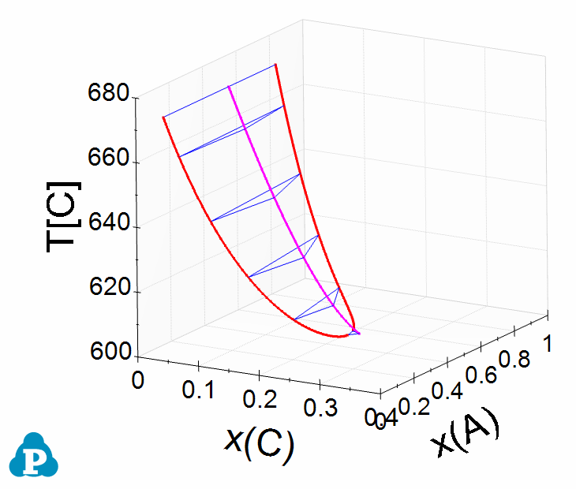
Ternary Three-Phase Equilibrium - Case IV
Liquid+Fcc+Fcc Tie-triangle changes in ternary field
Liquid phase: Fuchsia
Fcc phase: Red

Slide 51
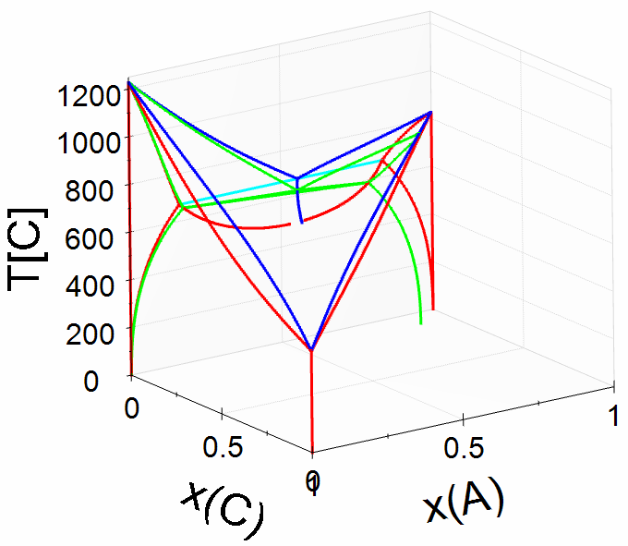
Ternary Three-Phase Equilibrium - Case IV
Isopleth through B-A_{0.9}C_{0.1} (Green line in 3D view)

Slide 52
Ternary Three-Phase Equilibrium - Case V
Case V: One eutectic binary and Two isomorphous with Cigar shape phase boundary.

Slide 53
Ternary Three-Phase Equilibrium - Case V
Case V: Isothermal sections in decreasing T order.

Slide 54
Ternary Three-Phase Equilibrium - Case V
Liquidus has one univariant line starting from a maximum in the ternary field and ending at A-C binary, and only one primary phase field, Fcc.

Slide 55
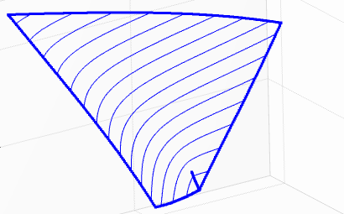
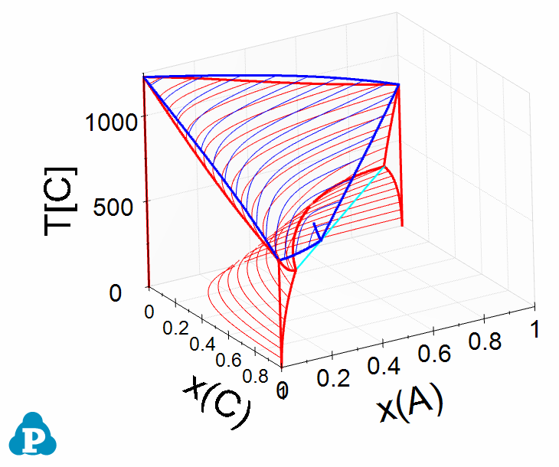
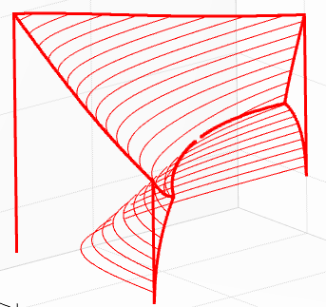
Ternary Three-Phase Equilibrium - Case V
Ternary phase fields in 3-D view
Liquid phase: Blue
Fcc phase: Red

Slide 56
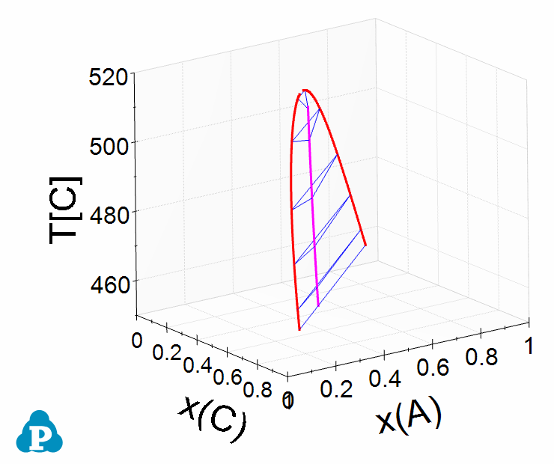
Ternary Three-Phase Equilibrium - Case V
Liquid+Fcc+Fcc Tie-triangle changes in ternary field
Liquid phase: Fuchsia
Fcc phase: Red

Slide 57
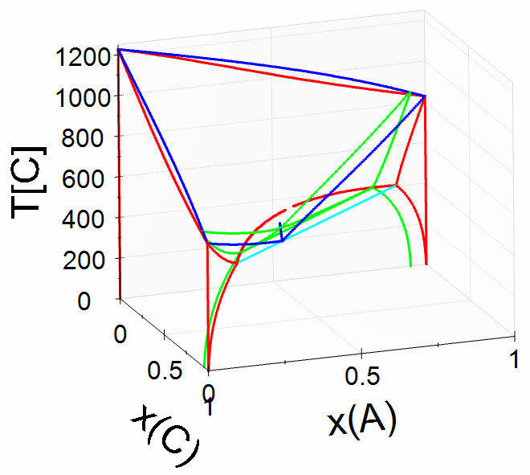
Ternary Three-Phase Equilibrium - Case V
Isopleth through B_{0.05}C_{0.95}-A_{0.95}B_{0.05} (Green line in 3D view)

Slide 58
Ternary Three-Phase Equilibrium - Case VI
Case VI: Two eutectic binary systems and one isomorphous with Cigar shape phase boundary.

Slide 59
Ternary Three-Phase Equilibrium - Case VI
Case VI: Isothermal sections in decreasing T order.

Slide 60
Ternary Three-Phase Equilibrium - Case VI
Liquidus lines start from a maximum in the ternary field, go separately in opposite directions and end at the two eutectic reactions in the binaries. Two primary phase fields, Fcc and Bcc.

Slide 61
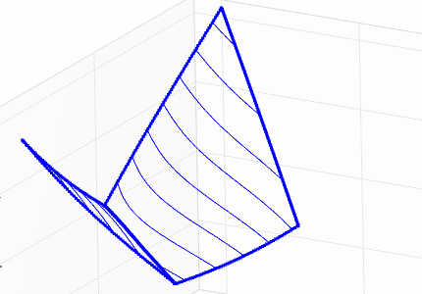
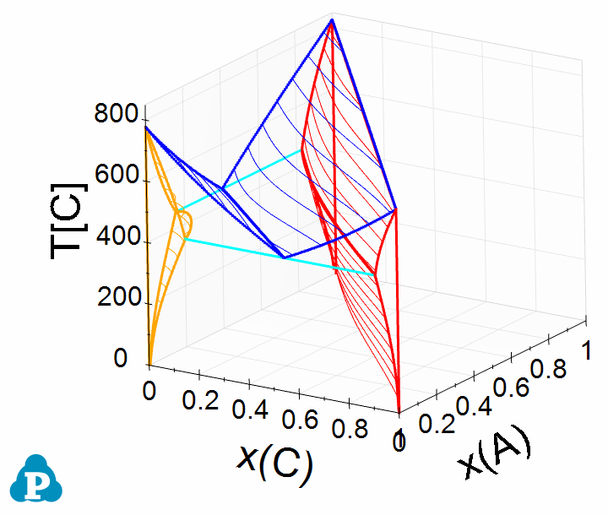
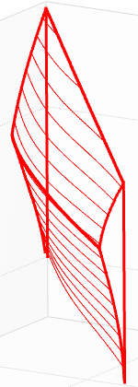
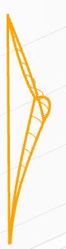
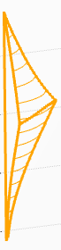
Ternary Three-Phase Equilibrium - Case VI
Ternary phase fields in 3-D view
Liquid phase: Blue
Fcc phase: Red
Bcc phase: Orange

Slide 62
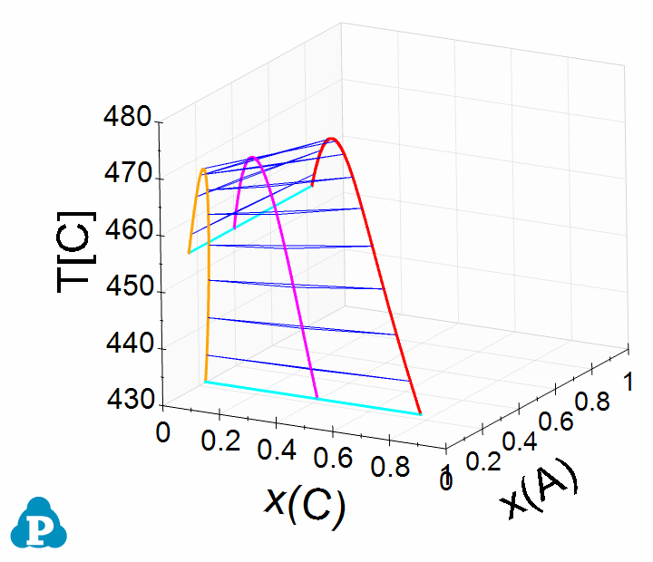
Ternary Three-Phase Equilibrium - Case VI
Liquid+Fcc+Fcc Tie-triangle changes in ternary field
Liquid phase: Fuchsia
Fcc phase: Red
Bcc phase: Orange

Slide 63
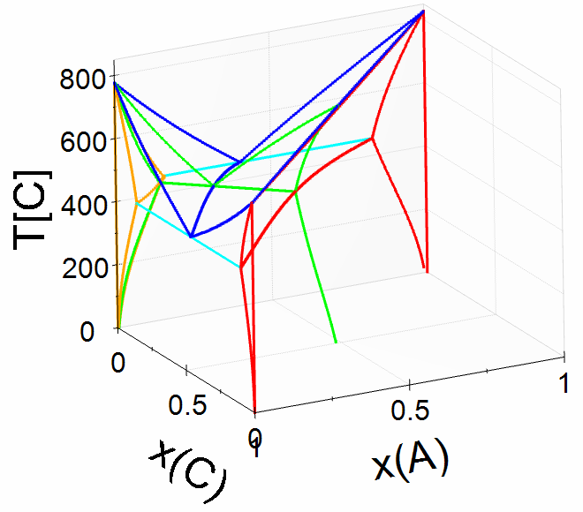
Ternary Three-Phase Equilibrium - Case VI
Isopleth through B-A_{0.5}C_{0.5} (Green line in 3D view)

Slide 64
Ternary Three-Phase Equilibrium - Case VII
Case VII: The binaries are the same as those in Case VI. Isothermal sections in decreasing T order.

Slide 65
Ternary Three-Phase Equilibrium - Case VII
Liquidus lines start from the two eutectic reactions in the binaries, join together at a minimum in the ternary field. Two primary phase fields, Fcc and Bcc.

Slide 66
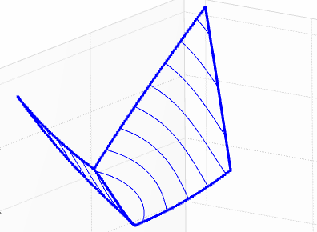
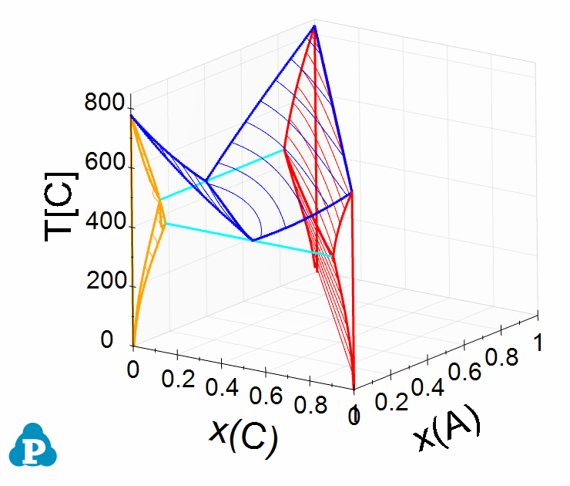
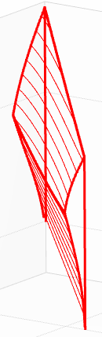
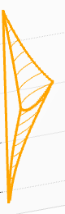
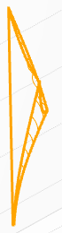
Ternary Three-Phase Equilibrium - Case VII
Ternary phase fields in 3-D view
Liquid phase: Blue
Fcc phase: Red
Bcc phase: Orange

Slide 67
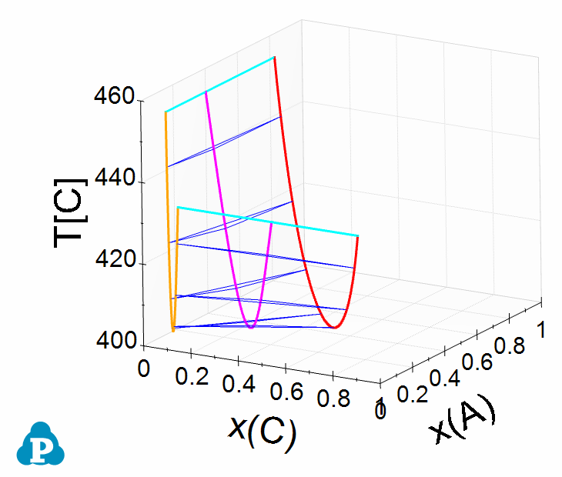
Ternary Three-Phase Equilibrium - Case VII
Liquid+Fcc+Fcc Tie-triangle changes in ternary field
Liquid phase: Fuchsia
Fcc phase: Red
Bcc phase: Orange

Slide 68

Ternary Three-Phase Equilibrium - Case VII
Isopleth through B-A_{0.5}C_{0.5} (Green line in 3D view)

Slide 69
Types of Ternary Phase Diagrams
Isomorphous System
Ternary Three-phase Equilibrium
Ternary Four-phase Equilibrium
  Class I Reaction
  Class II Reaction
  Class III Reaction
Congruent Transformation
A Complex System

Slide 70
Ternary Four-Phase Equilibrium – Class I
Class I: Three eutectic binary systems.

Slide 71
Ternary Four-Phase Equilibrium – Class I
Class I: Isothermal sections in decreasing T order.

Slide 72
Ternary Four-Phase Equilibrium – Class I
Liquidus lines start from the three eutectic reactions in the binaries, join together at one point in the ternary field. Three primary phase fields, Fcc, Bcc and Hcp.

Slide 73





Ternary Four-Phase Equilibrium – Class I
Ternary phase fields in 3-D view
Liquid phase: Blue
Fcc phase: Red
Bcc phase: Orange
Hcp phase: Fuchsia
Invariant: Aqua

Slide 74

Ternary Four-Phase Equilibrium – Class I
Liquid involved Tie-triangle changes in ternary field
Liquid phase: Blue
Fcc phase: Red
Bcc phase: Orange
Hcp phase: Fuchsia
Invariant: Green

Slide 75
Ternary Four-Phase Equilibrium – Class I
Isopleths through 40 at.% C and 50 at.% C

Slide 76
Ternary Four-Phase Equilibrium – Class I
Isopleths through B-A_{0.6}C_{0.4} and B-A_{0.415}C_{0.585}

Slide 77
Ternary Four-Phase Equilibrium – Class I
Characteristics to determine whether it is a Class I four-phase equilibrium:
Before Reaction: 3 three-phase triangles
After Reaction: 1 three-phase triangle
β
β
α
α
Φ+α+β
Φ
α+β+γ
Φ+α+γ
Φ+β+γ
γ
γ
Before Reaction
After Reaction
Class I reaction: Φ => α + β + γ

Slide 78
Ternary Four-Phase Equilibrium – Class I
Class I, Case 2: Four-phase equilibrium with two liquids involved, One monotectic, one eutectic and one isomorphous binary systems.

Slide 79
Ternary Four-Phase Equilibrium – Class I
Class I: Isothermal sections in decreasing T order.

Slide 80
Ternary Four-Phase Equilibrium – Class I
Class I: Enlarged isothermal sections before and after the Class I invariant reaction.
L₁ => L₂ + Bcc + Fcc

Slide 81
Ternary Four-Phase Equilibrium – Class I
Liquidus lines are separated into two parts:
A-rich part starts from the monotectic and eutectic reactions in A-B binary and the liquid miscibility gap in ternary field, join together at the invariant reaction.
A-poor part starts from the monotectic reaction in A-B binary, joins with the liquid miscibility gap in ternary field and then ends in eutectic reaction in B-C binary.

Slide 82




Ternary Four-Phase Equilibrium – Class I
Ternary phase fields in 3-D view
Liquid phase: Blue
Fcc phase: Red
Bcc phase: Orange
Hcp phase: Fuchsia
Invariant: Aqua

Slide 83


Ternary Four-Phase Equilibrium – Class I
Liquid involved Tie-triangle changes in ternary field
Liquid phase: Blue
Fcc phase: Red
Bcc phase: Fuchsia
Invariant: Green

Slide 84
Types of Ternary Phase Diagrams
Isomorphous System
Ternary Three-phase Equilibrium
Ternary Four-phase Equilibrium
  Class I Reaction
  Class II Reaction
  Class III Reaction
Congruent Transformation
A Complex System

Slide 85
Ternary Four-Phase Equilibrium – Class II
Class II: Two eutectic binary and one peritectic binary systems.

Slide 86
Ternary Four-Phase Equilibrium – Class II
Class II: Isothermal sections in decreasing T order.

Slide 87
Ternary Four-Phase Equilibrium – Class II
Liquidus lines start from the peritectic reaction in A-B binary and the eutectic reaction in A-C binary, join together at one point in the ternary field and then go to the eutectic reaction in B-C binary. Three primary phase fields, Fcc, Bcc and Hcp.

Slide 88





Ternary Four-Phase Equilibrium – Class II
Ternary phase fields in 3-D view
Liquid phase: Blue
Fcc phase: Red
Bcc phase: Orange
Hcp phase: Fuchsia
Invariant: Aqua

Slide 89

Ternary Four-Phase Equilibrium – Class II
Liquid involved Tie-triangle changes in ternary field
Liquid phase: Blue
Fcc phase: Red
Bcc phase: Orange
Hcp phase: Fuchsia
Invariant: Green

Slide 90
Ternary Four-Phase Equilibrium – Class II
Isopleths through 25 at.% A and 20 at.% A

Slide 91
Ternary Four-Phase Equilibrium – Class II
Characteristics to determine whether it is a Class II four-phase equilibrium:
Before Reaction: 2 three-phase triangles
After Reaction: 2 three-phase triangles
β
β
α
α
Φ+α+β
α+β+γ
Φ+α+γ
Φ+β+γ
Φ
Φ
γ
γ
Before Reaction
After Reaction
Class II reaction: Φ + α => β + γ

Slide 92
Ternary Four-Phase Equilibrium – Class II
Class II, Case 2: Four phase equilibrium with two liquids involved, One monotectic, one eutectic and one isomorphous binary systems.

Slide 93
Ternary Four-Phase Equilibrium – Class II
Class II: Isothermal sections in decreasing T order.

Slide 94
Ternary Four-Phase Equilibrium – Class II
Class II: Enlarged isothermal sections before and after the type II invariant reaction.
L₁ + Bcc => L₂ + Fcc

Slide 95
Ternary Four-Phase Equilibrium – Class II
Liquidus lines are separated into two parts:
A-rich part starts from the monotectic and eutectic reactions in A-B binary, join together at the invariant reaction and then ends at the liquid miscibility gap in ternary field.
A-poor part starts from the monotectic reaction in A-B binary, separate into two directions after invariant reaction, one ends at the liquid miscibility gap in ternary field and the other ends in eutectic reaction in B-C binary.

Slide 96




Ternary Four-Phase Equilibrium – Class II
Ternary phase fields in 3-D view
Liquid phase: Blue
Fcc phase: Red
Bcc phase: Orange
Hcp phase: Fuchsia
Invariant: Aqua

Slide 97


Ternary Four-Phase Equilibrium – Class II
Liquid involved Tie-triangle changes in ternary field
Liquid phase: Blue
Fcc phase: Red
Bcc phase: Fuchsia
Invariant: Green

Slide 98
Types of Ternary Phase Diagrams
Isomorphous System
Ternary Three-phase Equilibrium
Ternary Four-phase Equilibrium
  Class I Reaction
  Class II Reaction
  Class III Reaction
Congruent Transformation
A Complex System

Slide 99
Ternary Four-Phase Equilibrium – Class III
Class III: One eutectic binary and two peritectic binary systems.

Slide 100
Ternary Four-Phase Equilibrium – Class III
Class III: Isothermal sections in decreasing T order.

Slide 101
Ternary Four-Phase Equilibrium – Class III
Liquidus lines start from the eutectic reaction in A-B binary, split into two directions in the ternary field and end at the peritectic reactions in A-C and B-C binaries. Three primary phase fields, Fcc, Bcc and Hcp.

Slide 102





Ternary Four-Phase Equilibrium – Class III
Ternary phase fields in 3-D view
Liquid phase: Blue
Fcc phase: Red
Bcc phase: Orange
Hcp phase: Fuchsia
Invariant: Aqua

Slide 103

Ternary Four-Phase Equilibrium – Class III
Liquid involved Tie-triangle changes in ternary field
Liquid phase: Blue
Fcc phase: Red
Bcc phase: Orange
Hcp phase: Fuchsia
Invariant: Green

Slide 104
Ternary Four-Phase Equilibrium – Class III
Isopleths through 65 at.% C and 72 at.% C

Slide 105
Ternary Four-Phase Equilibrium – Class III
Characteristics to determine whether it is a Class III four-phase equilibrium:
Before Reaction: 1 three-phase triangle
After Reaction: 3 three-phase triangles
β
β
α
α
Φ+α+β
Φ
α+β+γ
Φ+α+γ
Φ+β+γ
γ
γ
Before Reaction
After Reaction
Class III reaction: α + β + γ => Φ

Slide 106
Types of Ternary Phase Diagrams
Isomorphous System
Ternary Three-phase Equilibrium
Ternary Four-phase Equilibrium
  Class I Reaction
  Class II Reaction
  Class III Reaction
Congruent Transformation
A Complex System

Slide 107
Congruent Transformation – Case I
Case I: Congruent melting in one binary and form a pseudo-binary in the ternary field.

Slide 108
Congruent Transformation – Case I
Case I: Isothermal sections in decreasing T order.

Slide 109
Congruent Transformation – Case I
Case I: Isothermal sections in decreasing T order.

Slide 110
Congruent Transformation – Case I
The isopleth through A_{0.5}B_{0.5}-C is a pseudo-binary system.

Slide 111
Congruent Transformation – Case I
The isopleth through A_{0.5}B_{0.5}-C cuts the liquidus projection into two parts and each one contains a class I four-phase equilibrium. The red point is a maximum in the liquidus surface.

Slide 112






Congruent Transformation – Case I
Ternary phase fields in 3-D view
Liquid phase: Blue
Fcc phase: Red
Bcc phase: Orange
Hcp phase: Fuchsia
Delta phase: Pink
Invariant: Aqua

Slide 113

Congruent Transformation – Case I
Liquid involved Tie-triangle changes in ternary field
Liquid phase: Blue
Fcc phase: Red
Bcc phase: Orange
Hcp phase: Fuchsia
Delta phase: Pink
Invariant: Aqua
Tie-triangle: Green

Slide 114
Congruent Transformation – Case II
Case II: Congruent melting in one binary but do not form a pseudo-binary in the ternary field. Binaries are the same as in Case I.

Slide 115
Congruent Transformation – Case II
Case II: Isothermal sections in decreasing T order.

Slide 116
Congruent Transformation – Case II
Case II: Isothermal sections in decreasing T order.

Slide 117
Congruent Transformation – Case II
The isopleth through A_{0.5}B_{0.5}-C is not a pseudo-binary system.

Slide 118
Congruent Transformation – Case II
The liquidus projection contains one class I four-phase equilibrium and one class II four-phase equilibrium.

Slide 119






Congruent Transformation – Case II
Ternary phase fields in 3-D view
Liquid phase: Blue
Fcc phase: Red
Bcc phase: Orange
Hcp phase: Fuchsia
Delta phase: Pink
Invariant: Aqua

Slide 120

Congruent Transformation – Case II
Liquid involved Tie-triangle changes in ternary field
Liquid phase: Blue
Fcc phase: Red
Bcc phase: Orange
Hcp phase: Fuchsia
Delta phase: Pink
Invariant: Aqua
Tie-triangle: Green

Slide 121
Congruent Transformation – Case III
Case III: Binaries are all eutectic systems, and there is a ternary compound which melts congruently in the ternary field.

Slide 122
Congruent Transformation – Case III
Case III: Isothermal sections in decreasing T order.

Slide 123
Congruent Transformation – Case III
Case III: Isothermal sections in decreasing T order.

Slide 124
Congruent Transformation – Case III
The delta primary phase appears as an island in the ternary field and there are three class I four-phase equilibria. The red points are three maximums in the liquidus surface.

Slide 125






Congruent Transformation – Case III
Ternary phase fields in 3-D view
Liquid phase: Blue
Fcc phase: Red
Bcc phase: Orange
Hcp phase: Fuchsia
Delta phase: Pink
Invariant: Aqua

Slide 126

Congruent Transformation – Case III
Liquid involved Tie-triangle changes in ternary field
Liquid phase: Blue
Fcc phase: Red
Bcc phase: Orange
Hcp phase: Fuchsia
Delta phase: Pink
Invariant: Aqua
Tie-triangle: Green

Slide 127
Types of Ternary Phase Diagrams
Isomorphous System
Ternary Three-phase Equilibrium
Ternary Four-phase Equilibrium
  Class I Reaction
  Class II Reaction
  Class III Reaction
Congruent Transformation
A Complex System

Slide 128
A Complex Ternary System
A complex ternary system involving all three classes of four-phase equilibrium.
Binaries contain three solid solution phases: Fcc, Bcc, and Hcp, and three intermetallic compounds: Delta, Gamma and Epsilon.

Slide 129
Congruent Transformation – Case III
Isothermal sections showing the invariant reaction 1 in detail.
Class I: Delta => Liquid + Gamma + Bcc

Slide 130
Congruent Transformation – Case III
Isothermal sections showing the invariant reaction 2 in detail.
Class II: Liquid + Bcc => Gamma + Hcp

Slide 131
Congruent Transformation – Case III
Isothermal sections showing the invariant reaction 3 in detail.
Class I: Liquid => Gamma + Fcc + Hcp

Slide 132
Congruent Transformation – Case III
Isothermal sections showing the invariant reaction 4 in detail.
This reaction occurs in the solid state.
Class III: Gamma + Bcc + Hcp => Epsilon

Slide 133
Congruent Transformation – Case III
There are three four-phase equilibria on the liquidus surface, two Class I reactions and one Class II reaction.

Slide 134







A Complex Ternary System
Ternary phase fields in 3-D view above 440ºC
Liquid phase: Blue
Fcc phase: Red
Bcc phase: Orange
Hcp phase: Fuchsia
Delta phase: Pink
Gamma phase: Green
Invariant: Aqua

Slide 135

A Complex Ternary System
Ternary phase fields in 3-D view below 440ºC
Bcc phase: Orange
Hcp phase: Fuchsia
Epsilon phase: Olive
Gamma phase: Green
Invariant: Aqua

Slide 136
Acknowledgement
Many of the slides are reproduced based on the book: Phase Diagrams in Metallurgy, Frederick N. Rhines.

Slide 137
For Download
The PowerPoint file and related thermodynamic database files are available for downloading under the directory: Resources/Downloads.
Thank you for your interest.

